Slide 1
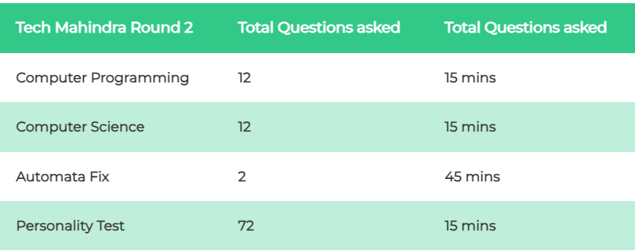
Welcome to Techie CodeBuddy

Slide 2
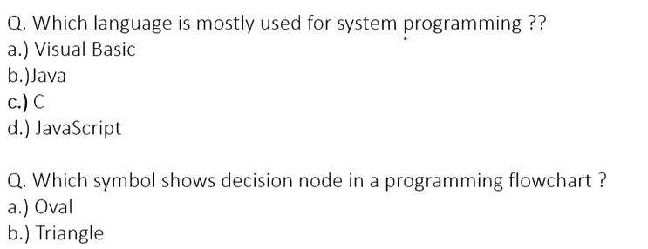
C) Circle
D) Diamond

Slide 3



Slide 4
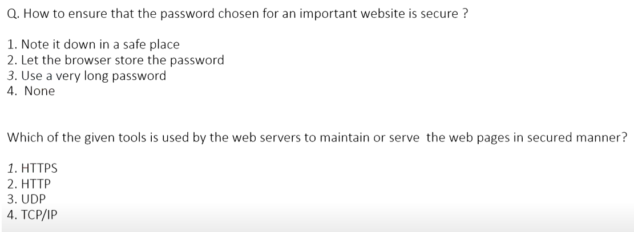

Slide 5



Slide 6
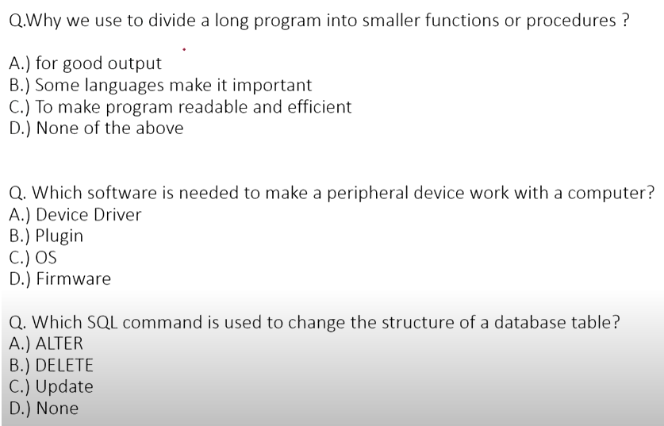

Slide 7



Slide 8


Slide 9




Slide 10



Slide 11




Slide 12




Slide 13


Slide 14
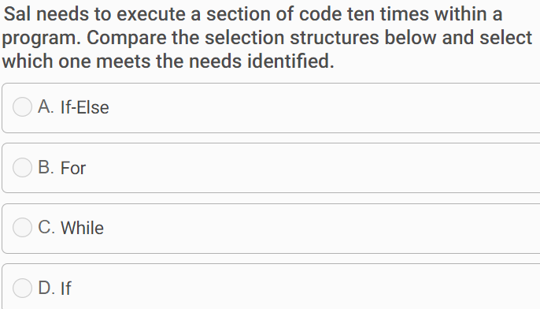

Slide 15
